Slide 1
Perceptron

Slide 2
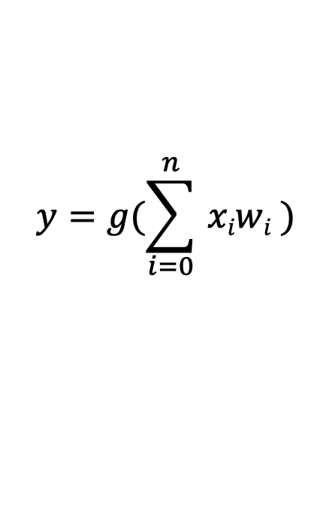
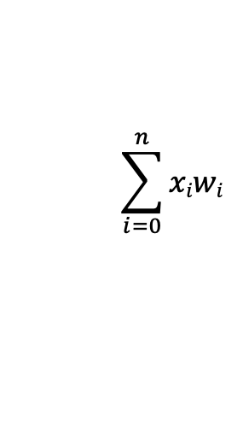

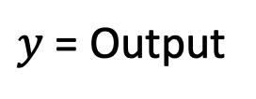

Perceptron: Forward Propagation
bias
X₀
Non-linear Activation
function
X₁
W₀ = 1
$$y=g(\sum_{i=0}^{n}{ xiwi} )$$
W₁
$$<$$
$$<$$
$$\sum_{i=0}^{n}{xiwi}$$
$y$ = Output
X₂
W₂
g(.)
W_{n}
x_{n}
Inputs
Learnable Parameters
Sum
Non-Linearity
Output

Slide 3




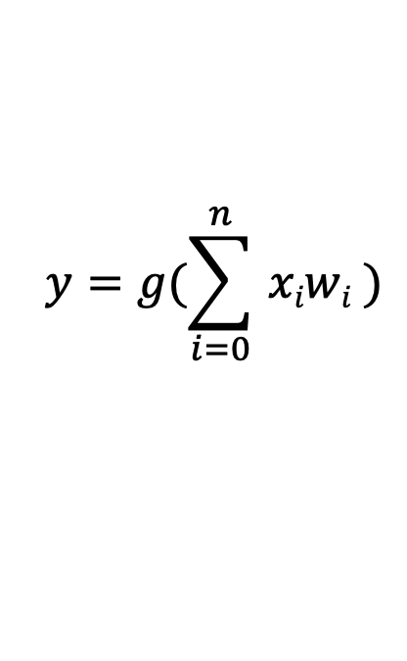

Perceptron: Forward Propagation
$$y=g(\sum_{i=0}^{n}{ xiwi} )$$
$$<$$
bias
X₀
Non-linear Activation
function
X₁
W₀ = 1
W
W₁
X^{T}
$$<$$
$$\sum_{i=0}^{n}{xiwi}$$
$y$ = Output
1
X₂
W₂
$g$(.)
$$<$$
W₁
$$y=g$$
X₀ X₁ .. X_{n}
x
W_{n}
W_{n}
x_{n}
$$<$$
$$y=g(XT.W)$$
Inputs
Learnable Parameters
Sum
Non-Linearity
Output

Slide 4
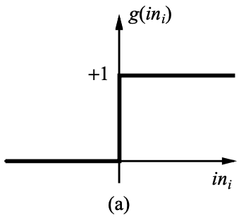
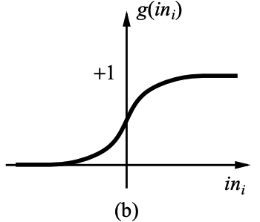
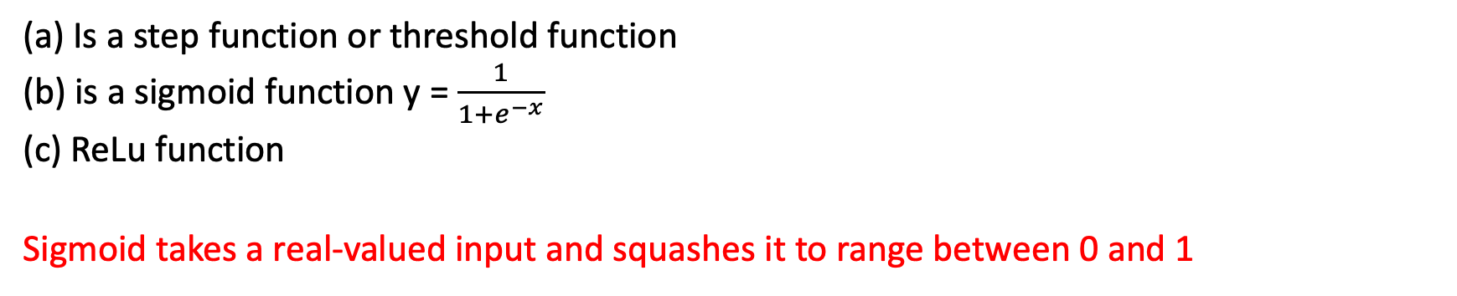
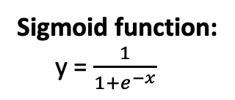
Activation function
ReLU function:
x x => 0
0 x < 0
Sigmoid function:
y = $\frac{1}{1+e^{−x}}$
y
y
y
y =
x
x
x
(c)
(a) Is a step function or threshold function
(b) is a sigmoid function y = $\frac{1}{1+e^{−x}}$
(c) ReLu function
Sigmoid takes a real-valued input and squashes it to range between 0 and 1

Slide 5
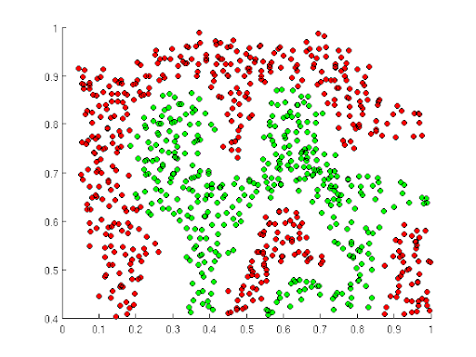
Importance of Activation Functions
The purpose of activation functions is to introduce non-linearities into the network.

Slide 6
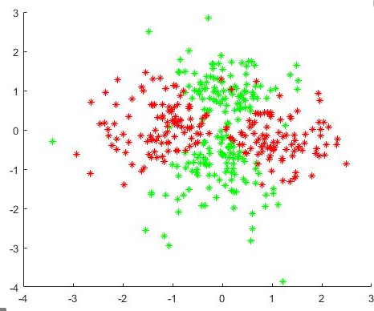
Importance of Activation Functions
Build a neural network to distinguish green vs. red points

Slide 7

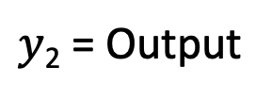
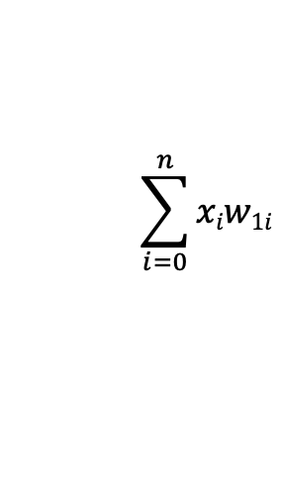
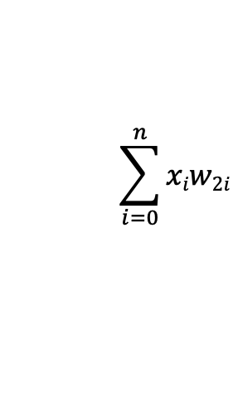
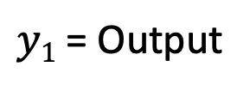
Multi Output Perceptron
Non-linear Activation
function
$$<$$
$$\sum_{i=0}^{n}{xiw1i}$$
$y1$ = Output
X₀
$g$(.)
X₁
Non-linear Activation
function
$$<$$
$$\sum_{i=0}^{n}{xiw2i}$$
$y$₂ = Output
x_{n}
$g$(.)

Slide 8

Derivative
The derivative $\frac{df(x)}{dx}$of a function f(x)
at x = a provides the slope of the
curve at x=a

Slide 9

Calculate Derivative with Pytorch
f(x) = 9x⁴ + 2x³ + 3x² + 6x + 1
$\frac{df(x)}{dx}$ = 36 x³+6x²+6x+6 | _{x=2}
36*(2)³+6*(2)²+6*2+6 =330

